Slide 1
Getting Started With Linux Commands
FOSS LAB

Slide 2
Basic Linux Commands

Slide 3
Topics covered
Creating files and directories
Your current directory
Changing directories
Viewing contents of a file
Copying, renaming or deleting files or directories
Help

Slide 4
Creating files and directories
Normally we can create a file using a text editor
You can use the touch command to create a file
touch <file name>
To create a directory, use the mkdir command
mkdir <directory name>

Slide 5
Current Directory
The directory in which you are working is called current directory or working directory.
The name of the working directory can be found out by using the command pwd

Slide 6
Change directory
Typing
cd <dir_name>
will take you to subdirectory <dir_name>
Use the command cd to move to a different directory

Slide 7
Special directories
Current directory - .
Parent directory of the current directory - ..
Home directory - ~
Root directory - /
Another user’s directory - ~<username>
There are 5 directories having special symbols

Slide 8
Viewing contents of a text file
cat <filename> will cause the text to scroll off the screen
cat can also be used concatenate multiple files
cat <file1> <file2> will concatenate two files and then display on terminal

Slide 9
Viewing contents of a text file
more <filename> will display the file one scornful at a time, press spacebar advance to next screen and press return to scroll up one line and q to quit.
less <filename> command is similar to more but the command less is faster than more on large files.
Use a text editor

Slide 10
Listing files and directories
ls -l will provide a long listing of contents of the current directory
ls -l -h will provide the same information as above but the size will be in human readable units like KB, MB
ls -F will mark all files that are executable with a * and all directories with a /
ls --color will show a coloured listing of files - directories in blue executables in green
ls -a will show all files in current directory, including the special “dot files”
Command ls will list the names of files and directories in your current directories
There are several options for this command

Slide 11
Copying files and directories
To make the copy of a file, use cp <file1> <file2>
If file2 already exists it will be overwritten
Copy a file into another directory, use
cp <file1> <dir_name>
To copy one directory into another use
cp -r <dir_name1><dir_name2>
The -r command is used to recursively perform the copy operation , i.e to copy all subdirectories in the first directory to second one
Command cp is used to perform the copy operation

Slide 12
Renaming/moving files and directories
mv <old_filename> <new_filename> to rename a file
mv <old_dirname> <new_dirname> to rename a directory
mv <filename> <dirname> to move a file into another directory
Command mv is used to perform the move operation

Slide 13
Removing/deleting files and directories
rm <filename> to remove a file
rmdir <dirname> to remove an empty directory
rmdir -rf <dirname> to remove a non empty directory
Command rm is used to perform the remove operation

Slide 14
Some more useful commands
clear clears the terminal screen
locate search for a specified file name
passwd allows to change the password
whoami displays the currently logged in user

Slide 15
Getting help
man pages : Online man pages are available in every linux system
man <command_name> : used to find out about a command and what it does
man -f <command_name> : one line summary of what a command does
man -k <keyword> : to find a command that does something for you

Slide 16
Directory Structure

Slide 17
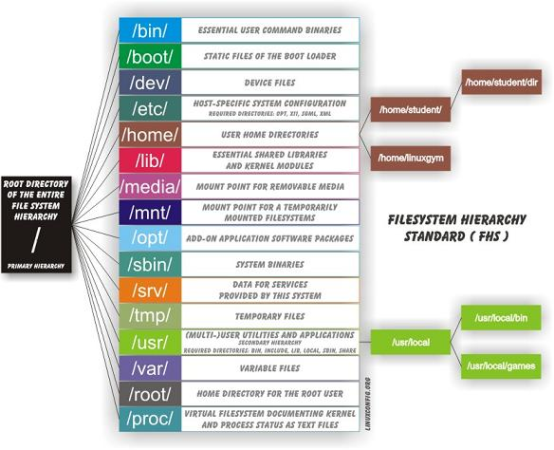

Slide 18
Executing files

Slide 19
Executing files
cd to the directory which contains the file to be executed
Type chmod +x name_of_file.sh to make the file executable
Type sh ./name_of_file.sh to execute the file

Slide 20
Thank you !

